Slide 1

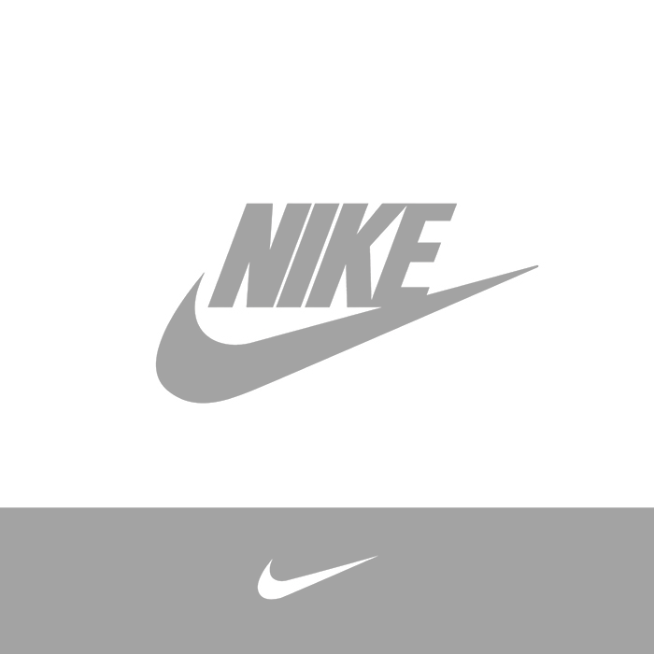



STUDENT NAME
SUDENT ID:
COURSE CODE:
DATE:
Strategic Analysis and Simulation Reflection Report – Nike in the UK Clothing Retail Industry

Slide 2


NIKE
INC
TABLE OF CONTENTS
  Part I – Strategic Analysis of Nike Clothing Retailing
    Introduction
    PESTLE Analysis of the UK Macro Environmen
    Industry Analysis: Structure, Value Chain, and Drivers
    Industry Attractiveness: Five Forces
    Strategic Group and Competitor Analysis
    Resources, Capabilities, and VRIO Analysis
    Business-Level Strategy: Differentiation
    Non-Market Strategy: ESG and SDGs
    Digital and Innovation Strategy
    Conclusion: Strategic Fit
  Part II. Reflection on the Simulation
    Simulation Reflection: Round 3 Decisions
    Simulation Reflection: Teamwork, Mistakes, and Skills Learned
  Simulation game summary
  References

Slide 3
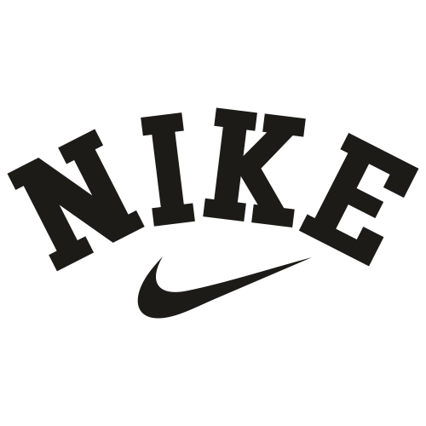
PART I – STRATEGIC ANALYSIS OF NIKE CLOTHING RETAILING

Slide 4
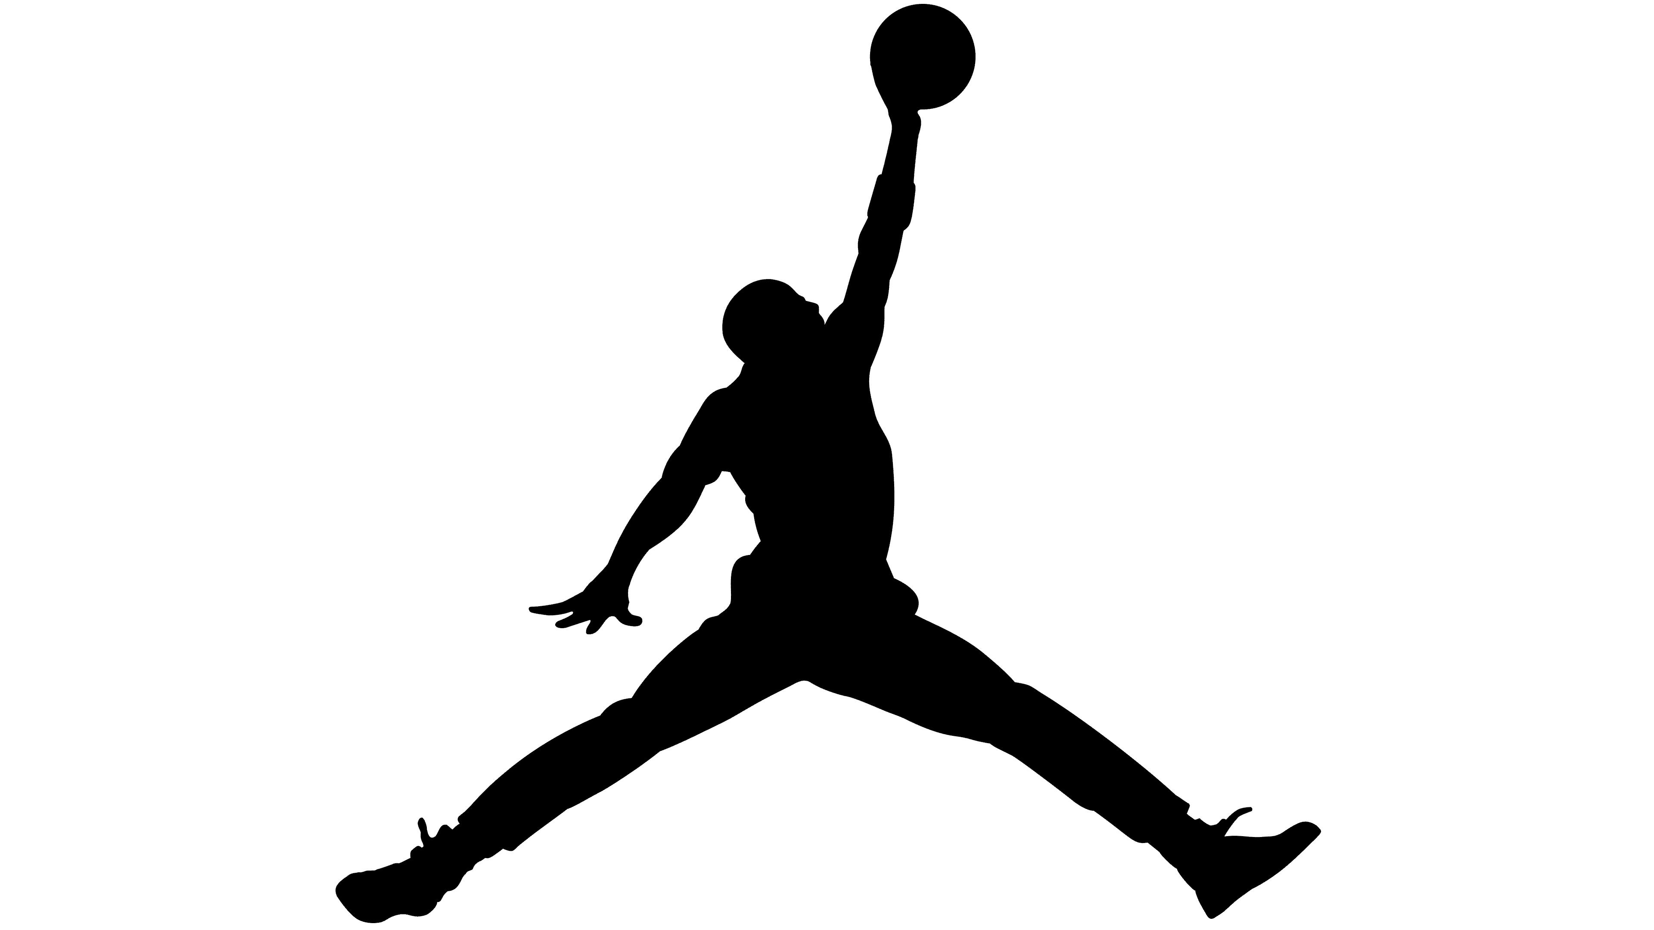

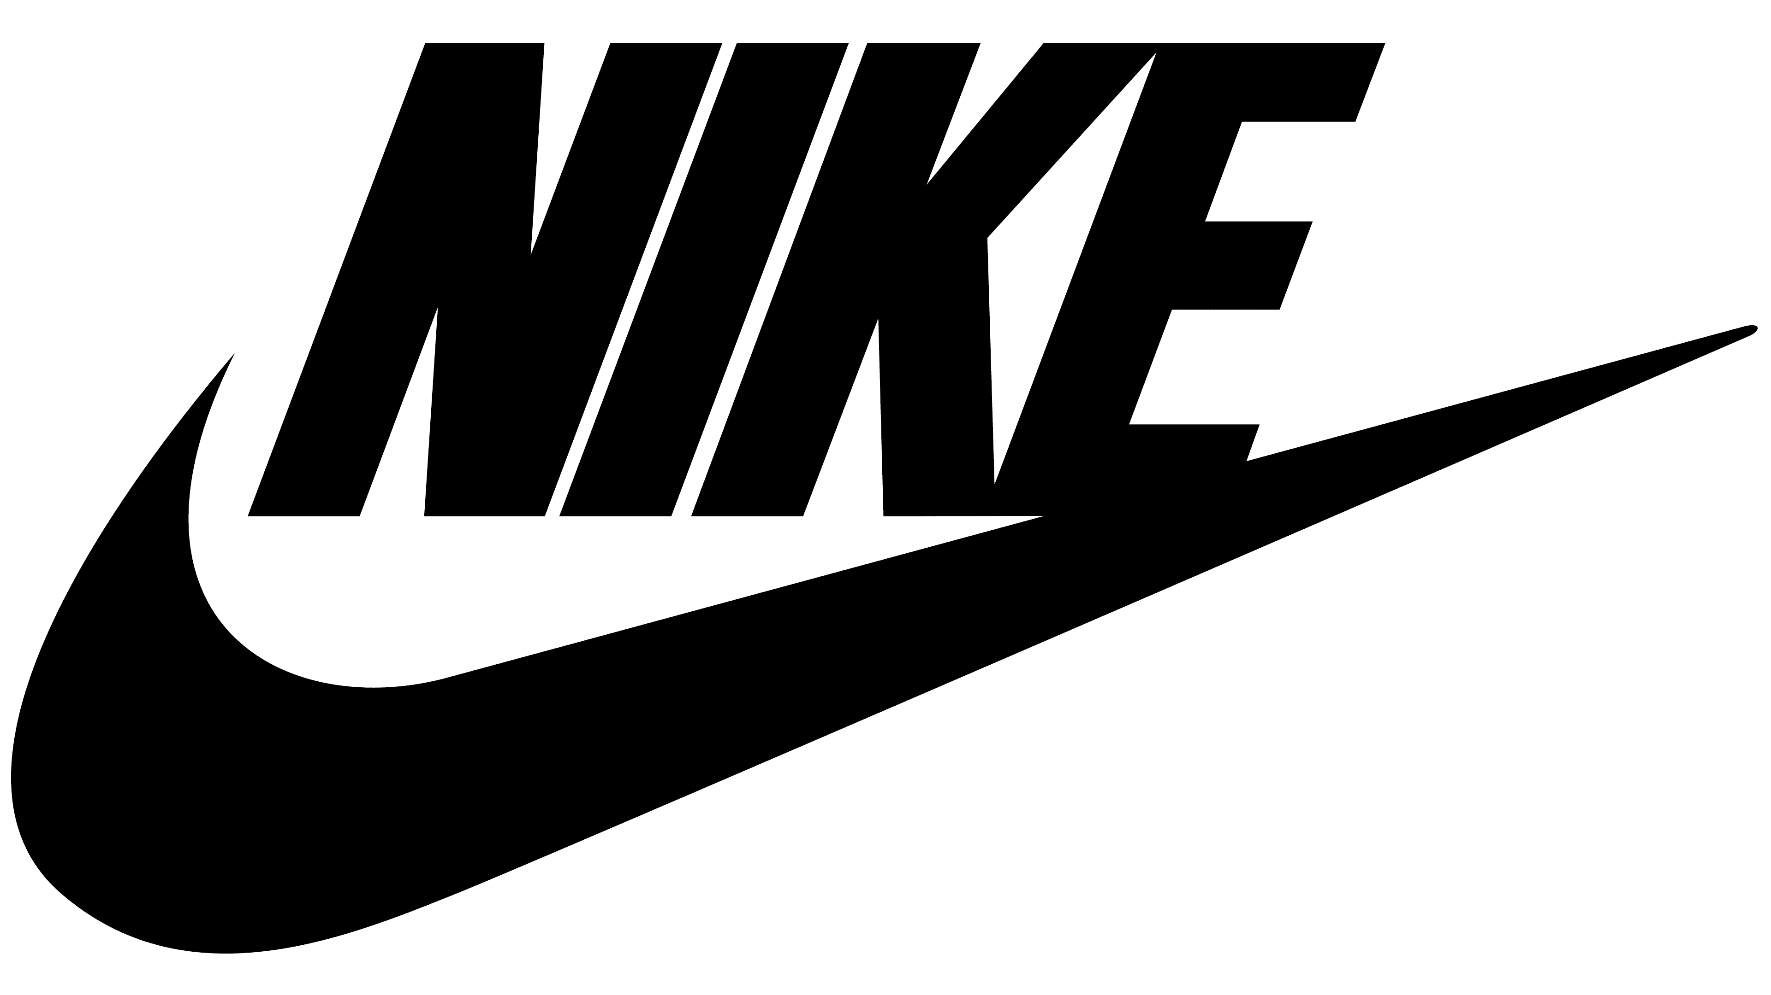
INTRODUCTION
Purpose of the report: This report looks at the strategic fit of Nike through coordinated analysis between the external macro-environmental pressures and internal strengths. It also examines the major non-market actions and ponders on how these actions combine to impact performance.
Introduction to the company:
Nike, founded in 1964 as Blue Ribbon Sports and renamed Nike in 1971 in honour of the Greek goddess of victory, in honour of the Greek goddess of victory and has since become a force to reckon with in the UK clothing retail sector with a total of £1.2bn revenue in 2025 in an industry of £88.86bn apparel (Statista, 2025). The UK strength of it is determined by a strong retail network, sound digital platform and rising online activity that constitute approximately 40 % of the total revenue (Nike Inc., 2025). Nike is known to have a “Just Do It” identity, and its innovation, athlete support and brand creativity have remained the core focus of the company, and recent developments have seen it concentrate on direct-to-consumer sales growth, digital service expansion and sustainability initiatives.
Product categories
Sportswear (tracksuits, hoodies, T-shirts)
Performance apparel (running, training, basketball, football)
Footwear (lifestyle and performance shoes)
Accessories (bags, socks, sports equipment) (Nike Inc Report, 2021)
Brand portfolio
Nike
Jordan
Converse
Mission: “To bring inspiration and innovation to every athlete in the world.”

Slide 5
PESTLE ANALYSIS OF THE UK MACRO ENVIRONMENT
Factor | Key Issue | Impact on Nike | Opportunity / Threat
Political | Brexit raised import tariffs on Asian-sourced apparel by 5–10%. | Higher tariff costs increase Nike’s import expenses and slow supply-chain efficiency, requiring Nike to optimise sourcing routes and renegotiate with logistics partners (Business Model Analyst, 2025). | Threat – increased costs + supply-chain friction.
Economic | UK inflation at 2.5% and GDP growth of 1.8% limit discretionary spending . | Cost-sensitive customers reduce mid-tier purchases, but Nike’s premium performance segment benefits as health-focused consumers still prioritise long-lasting, quality apparel (Panmore, 2024). | Opportunity – premium demand stays strong.
Social | Wellness culture is rising; 60% of millennials wear sportswear daily, and older consumers seek inclusive sizing (Lecture 02, 2025, p.15). | Athleisure demand reinforces Nike’s brand relevance, while demographic ageing creates room for Nike to expand inclusive designs and comfort-led apparel (MarketLine, 2025). | Opportunity – product line expansion.
Technological | AI-driven app fitting and e-commerce now form 35% of UK apparel sales. | Nike benefits from improved digital conversion, reduced returns, and stronger engagement within its direct-to-consumer ecosystem (DCFmodeling.com, n.d.). | Opportunity – digital-led growth.
Legal | Ethical sourcing and labour compliance requirements are increasing in UK retail. | Nike must enhance supplier audits and transparency structures, raising operational costs but improving brand trust and compliance reputation | Both – higher costs but stronger legitimacy.
Environmental | UK sustainability expectations and net-zero 2050 targets encourage recycled materials . | Nike’s “Move to Zero” initiative aligns well, improving eco-credibility and reducing environmental impact through recycled fabrics (FY23 NIKE Impact Report, 2024). | Opportunity – strengthens sustainability positioning.
To a certain degree, Nike is exposed to tariffs and compliance costs, which puts some pressure on the company; however, in general, the PESTLE environment is even biassed in favour of Nike. The brand is poised for tech-based retail, the emerging culture of wellness, and the sustainability trend. Nike has strength and strategic flexibility, as its Move to Zero strategy and digital investments align directly with macro environment trends in the UK.

Slide 6
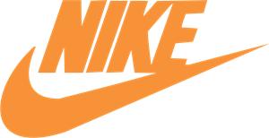
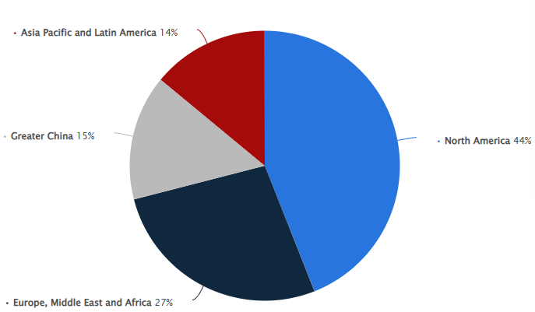
INDUSTRY ANALYSIS: STRUCTURE, VALUE CHAIN, AND DRIVERS
Structure
The UK clothing retail market is a fast-moving industry that is a mix of both the fashion and sporting industries, which forms an oligopolistic market structure with Nike, Adidas, Primark, and H&M, with an overall market share of 45%.
Its Herfindahl-Hirschman Index (HHI) is 1200, which is a moderate level of concentration (Tutor2u, 2024).
Competition on prices endangers the margins, but good brand equity safeguards high-end positioning (Lecture04, 2025, p. 2).
Value Chain
Nike's value chain encompasses the sourcing of cotton, design and manufacturing, distribution and retail
1,200 UK shops control 70% of the chain relative to the outsourced operations of its competitors, and it responds quickly (ADEC Innovations, n.d.).
Key Drivers
The most prominent change key drivers are:
digital disruption: a 30 per cent increase in e-retail
sustainability goals: 50 per cent recycled materials by 2025
Global supply chain exposure (FY23 NIKE Impact Report, 2024).
Those drivers are converted into competitive advantages by making the potential threats into AI-driven predictions and integrating the circular economy.
Evaluation: The current trends of digital disruption, sustainability, and supply chain issues are on the move, and Nike should be innovative and agile. Its good value chain and brand equity enable it to convert these issues into a competitive edge, besides enabling it to offer its differentiation strategy in the UK.

Slide 7
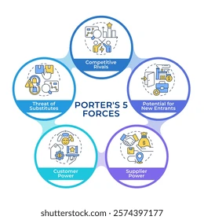

INDUSTRY ATTRACTIVENESS: FIVE FORCES
1. Threat of New Entrants – Medium
High capital needed for national presence (£50m+)
Strong brand equity of incumbents
Online platforms allow niche entry
Economies of scale favour established brands
2. Threat of Substitutes – High
Fast-fashion offers cheaper trend-driven apparel
Low switching costs
Online leisure/athleisure brands emerging
Rapid fashion trend changes
3. Buyer Power – Strong
Consumers: teens to athletes
Apps, reviews, and social media increase leverage
Sustainability demands impact choices
Easy brand switching (Euromonitor International, 2025)
4. Supplier Power – Medium
Sourcing from multiple regions reduces dependency
Moderate supplier differentiation
Backward integration possible
Supply chain disruptions risk production
5. Competitive Rivalry – High
Slow market growth (~3.39%)
Promotional wars among Adidas, Puma, others
Differentiation and innovation critical
High marketing spend needed
Evaluation: Nike needs to innovate continuously in order to remain differentiated and protect its position in the market.

Slide 8
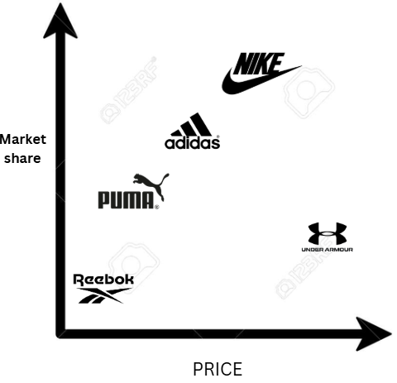
STRATEGIC GROUP AND COMPETITOR ANALYSIS
Feature | Nike | Adidas | Puma
Current Strategy | High-price, high-innovation; differentiation; sustainable apparel (Move to Zero) (Euromonitor International, 2024) | High-price, high-innovation; focus on sports equipment and performance | Urban & fashion-oriented; trend-driven apparel
Capabilities | Strong brand equity ($36bn); advanced tech (Flyknit); digital ecosystem; global supply chain (Statista, 2025) | Strong brand equity ($15bn); sports equipment expertise; global presence (Statista, 2025) | Trend responsiveness; urban marketing; moderate digital presence
Assumptions | Consumers value innovation, sustainability, and performance | Consumers value equipment performance and trusted sports brand | Consumers follow urban fashion and trends
Future Goals | Maintain differentiation, expand sustainability, lead in digital engagement, strengthen UK leadership | Expand product offerings, maintain global market share, leverage brand equity | Increase urban market share, strengthen digital sales
Analysis & conclusion: Against Adidas and Puma, Nike competes in the high-price, high-innovation segment, and has a high brand equity, first-mover advantages, and digital ecosystem. Competitors vary in terms of focus, and this creates overlaps in terms of resources and consumers. Innovation, brand strength, and sustainability initiatives can help Nike to remain differentiated and lead in the UK market (Lecture06, 2025, p.2).

Slide 9
RESOURCES, CAPABILITIES, AND VRIO ANALYSIS
INGOUDE
COMPANY
1. Resources
Physical: $10bn cash, 1,200 UK outlets → financial & distribution power
Intangible: Swoosh brand → valuable, rare, strong recognition
Technological: AI tools, digital platforms support customization and engagement (MarketLine, 2024)
2. Capabilities
Global supply chain → responsive to market changes
Marketing → celebrity endorsements, strong brand campaigns
Innovation & R&D → breakthrough products (high-performance & recycled fabrics)
3. Core Competencies
Innovation-driven differentiation
Sustainability initiatives (Move to Zero, recycled fabrics) (Mintel Academic, 2025)
Creativity and AI-enabled product customization
Resource/Capability | Valuable | Rare | Inimitable | Organized to Capture Value | Competitive Advantage
Brand (Swoosh) | Yes | Yes | Yes | Yes | Sustained advantage
Supply chain | Yes | Yes | Partially | Yes | Temporary advantage
Design/Innovation | Yes | Some | Some | Yes | Parity / potential growth
Creativity (AI, marketing) | Yes | Some | Some | Yes | Potential opportunity
Eveluation: The internal fit between the differentiation strategy and the resources and capabilities of Nike is good, especially the brand equity, innovation, and responsive supply chain. In order to maximise these strengths, the firm should have an agile organisation, which is able to react swiftly and convert resources into a long-term competitive edge and play defence against competitors.

Slide 10
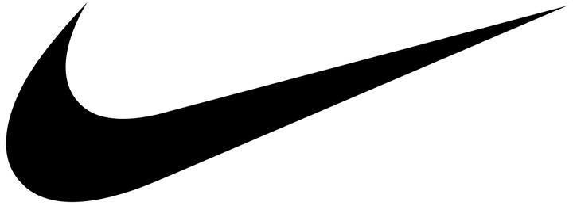
BUSINESS-LEVEL STRATEGY: DIFFERENTIATION
Strategy Overview
Target reasonable performance and dreamlike-style clothes.
Dri-FIT line: merges the performance technology and style for the sportsmen and the casual customers.
Based on VRIO-strong brand and innovation potential; $2bn spent on R&D to come up with unique features.
Blue Ocean opportunities: developing uncontested markets (Lecture 07, 2025, p. 9)
Competitive Advantage
Digital leadership: 40 per cent of UK online sales; the international market is superior to Puma.
Innovation contributes to the strength against the fast-fashion trends.
Sustainability initiatives lower expenses and enhance effectiveness (four-actions model).
Differentiation strategy is a strategic queen which dictates market positions.
Assessment: Good fit internally but, an agile organization will be required to make the most out of these resources. Resources are used as armour to protect against the undermining of competition.

Slide 11

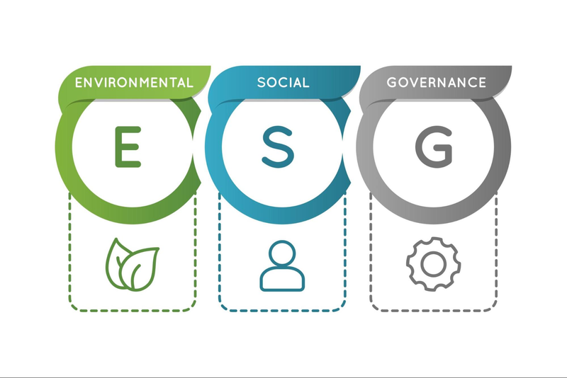
NON-MARKET STRATEGY: ESG AND SDGS
Performance Compared to Competitors
ESG integration is faster than the majority of competitors.
Weak reporting as compared to Lululemon (Sustainabilitymag.com, 2024)
The first company to incorporate SDG-related efforts, yet it has labour criticism issues. (ProPublica, 2024)
Environmental Initiatives
Move to Zero: targets zero waste and carbon neutrality by 2050 (Nike Inc, 2021)
Aligns with SDG 12 (responsible consumption) and SDG 13 (climate action)
100% renewable facilities expected by 2025 (About Nike, n.d.)
Rapid implementation of sustainability programs, faster than rivals
Social Initiatives
Diversity programmes: 50 per cent women in leadership and governance.
Supply chain ethical sourcing audits.
Strike a balance between profit and purpose to establish long-term stakeholder confidence.
Analysis: These structural forecasts are in high congruence with environmental and social demands, which enhance the competitive edge of Nike and help to strategically position it in the UK market (Lecture01, 2025, p. 2).

Slide 12


DIGITAL AND INNOVATION STRATEGY
Digital Transformation
Digital sales account for 40% of UK revenue (Nike Inc., 2025)
AI-driven tools enhance customer experience:
  Virtual fitting
  Personalized recommendations
  Targeted marketing applications
Supply chain innovation: predictive analytics, inventory optimization, circular economy principles
Innovation Capabilities
Flyknit sustainable materials and materials integration.
Customer loyalty and brand differentiation become stronger with the help of app-based engagement (Ouahchi & Chouchane, 2025).
The combination of technology and resources that are VRIO-driven with strategy would result in the achievement of sustained competitive advantage (Lecture 08, 2025, p. 2).
Strategic Alignment
Differentiation is enhanced by digital and innovation strategies.
Helps to maintain the consumer base and minimises the threat of the fashion rivals.
Digital ecosystems transform the strategic possibilities into market challenges and vice versa. Enhances agility, adaptability, and long-term resilience (IBISWorld, 2025).
Evaluation: The digital and innovation value chain offers Nike a good competitive advantage, enabling the company to differentiate products, build customer loyalty, and maintain growth in the UK retail clothing market.

Slide 13



CONCLUSION: STRATEGIC FIT
Strategic Alignment
Nike successfully integrates business-level differentiation and non-market strategies with high internal resources and capability in order to attain strategic fit (Germano, 2024).
The differentiation strategy is consistent with the macroeconomic forces, social tendencies and industry dynamics.
Nike has strengths in its supply chain, including agility and R&D that enable it to capitalise on the opportunities presented by the market, as demonstrated by VRIO strengths.
ESG and Non-Market Fit
Other ESG programmes and the Move to Zero programme satisfy all the environmental and social demands.
Increases trust of stakeholders and strengthens the position of Nike on the map of competitors.
Challenges and Strategic Response
Substitutes and the imitation of supply are still a threat and demand agile innovations and rapid changes in the strategy (Shahmm, 2025).
Strategic fit related capabilities to the external opportunities thereby improving resilience (Lecture01, 2025, p.2).
Final Insight
The strategy of Nike can be compared to that of a phoenix, as it conducts itself to fit in every changing situation by means of innovations, sustainability, and digital leadership to guarantee the ongoing growth, market relevance, and competitive advantage.

Slide 14

PART II. REFLECTION ON THE SIMULATION

Slide 15
SIMULATION REFLECTION: ROUND 3 DECISIONS
Role: Midsize sedan price setter; the company will do the price analysis and positioning on the market.
Key Decision: 15 per cent price cut to gain the economy segment, given that demand would fall by 20 per cent due to excess inventory by the competitors.
Strategy Alignment: Adhered to cost-leadership strategy, taking into consideration competitor bids, customer trends, and inventory projections.
Team Challenge: It emerged that there was debate on whether to go on aggressive discounting or to continue at premium pricing.
Mistake: Ignored fuel efficiency improvements, which meant a loss of 10 per cent of sales.
Lessons Learnt: Preliminary analytics, precise cooperation, and the ability to predict the actions of competitors are the key factors to successful decision-making.
Insight: Strategic actions are fundamental to competitive dynamics; hence, adaptation is important (Lecture 06, 2025, p. 32).
Overall Experience: Round was the one that demanded foresight, speed of adaptation and cooperation with other team members, like passing a relay baton.

Slide 16
SIMULATION REFLECTION: TEAMWORK, MISTAKES, AND SKILLS LEARNED
THE SKILLS THAT WERE REINFORCED BY THE SIMULATION INCLUDE ADAPTIVE LEADERSHIP, INTERPRETATION OF DATA, AND NEGOTIATING A SOLUTION TO CONFLICT INTO A REVELATION. ACCORDING TO LECTURE 8 (2025, P.2), WHICH STATES THAT “ADAPTIVE LEADERSHIP... IMPROVES ANALYTICAL THINKING. ALL IN ALL, THE EXPERIENCE UPHELD THE IMPORTANCE OF TEAMWORK, FORESIGHT, AND RAPID STRATEGIC CHANGES.
The Round 3 performance reflected a decrease of 8% in profits, which was mainly due to siloed decision-making, uneven discounting and a lack of input in our inventory, which undermined our response in the market.
The process of interacting as a team was not always cordial, and consensus can be delayed sometimes, and opinions are highly held, which resembles the competitive rivalry in the real world.
According to Qu in (Lecture05, 2025, p.2), the performance of the firms is determined by rivalry between the firms, and it was observed in our own group as well.
If given a second opportunity, I would establish better coordination, apply VRIO-type evaluation to organise the use of resources, and provide access to data dashboards to all team members to avoid oversights. Prior convergence of market analytics and systematic debate would have enhanced conformity.

Slide 17
Simulation game summary: Alen Josta Zhao’s Journey: Key Decisions, Performance Trends, and Lessons
Year | Net Income (M) | Stock Price | Market Share (%) | Cum. Net Income (M) | Key Trend
1 | 1,316 | 50.20 | 16.2 | 2,527 | Strong start with safety focus
2 | 1,477 | 58.12 | 16.3 | 4,004 | Peak growth through upgrades
3 | 1,277 | 62.03 | 15.9 | 5,281 | Expansion high, new vehicles launched
4 | 1,100 | 59.43 | 15.3 | 6,381 | Overproduction strains emerge
5 | 281 | 37.26 | 13.1 | 6,662 | Sharp decline, financing volatility
6 | -772 | 19.56 | 11.2 | 5,890 | Losses mount, production cuts
7 | -2,196 | 7.26 | 10.9 | 3,694 | Bust phase, market erosion
Strategic Highlights & Insights
The initial wave was based on robust marketing, technology improvements, and new base models; concept cars provided innovation, but with minimal success.
The new launches and expanded coverage of dealers in the middle of the game did not offer a steady demand pattern with unstable swings of the prices.
Performance was adversely affected by a pace in capacity increase that was excessively rapid, rising financing costs, and decision-making based on reaction in place of planned strategy.
Lesson learnt: ambitious actions should be backed by solid data, such as forecasting and focus groups, and keeping a better rein on debt would have stabilised performance.
General plot: increasing and then decreasing over a period of seven years, with share percentage going down to 11% and accumulated income reaching its peak and then plummeting.

Slide 18
REFERENCES
ADEC Innovations (n.d.) How does Nike’s supply chain work? Available at: https://www.adec-innovations.com/blogs/how-does-nikes-supply-chain-work/ .
About Nike (n.d.) Sustainable Development Goals. Available at: https://about.nike.com/en/resources/sustainable-development-goals-sdgs .
Business Model Analyst (2025) Nike PESTLE Analysis. Available at: https://businessmodelanalyst.com/nike-pestle-analysis/.
DCFmodeling.com (n.d.) NIKE, Inc. (NKE) PESTLE Analysis. Available at: https://dcfmodeling.com/products/nke-pestel-analysis
FY23 Nike Impact Report (2024) Nike Impact Report 2024. Available at: https://media.about.nike.com/files/2fd5f76d-50a2-4906-b30b-3b6046f36ebf/FY23_Nike_Impact_Report.pdf
Nike Inc. (2025) Annual Report 2025. Available at: https://www.sec.gov/Archives/edgar/data/320187/000032018725000047/nke-20250531.htm
Panmore (2024) Nike PESTEL/PESTLE Analysis. Available at: https://panmore.com/nike-inc-pestel-pestle-analysis-recommendations
ProPublica (2024) Nike pledged to shrink its carbon footprint. Available at: https://www.propublica.org/article/nike-layoffs-sustainability-climate-change
Qu, H. (2025) MGT3173 Lecture 01 – Introduction to this module. Middlesex University London.
Qu, H. (2025) MGT3173 Lecture 02 – Macro environment. Middlesex University London.
Qu, H. (2025) MGT3173 Lecture 04 – Industry analysis I. Middlesex University London.
Qu, H. (2025) MGT3173 Lecture 05 – Industry analysis II: Five Forces. Middlesex University London.
Qu, H. (2025) MGT3173 Lecture 06 – Strategic groups and industry dynamics. Middlesex University London.
Qu, H. (2025) MGT3173 Lecture 07 – Blue Ocean Strategy: Strategic Canvas. Middlesex University London.
Qu, H. (2025) MGT3173 Lecture 08 – Resources and capabilities. Middlesex University London.
Shahmm (2025) Nike’s strategic missteps: Lessons from a giant’s stumble (2017–2025). Available at: https://shahmm.medium.com/nikes-strategic-missteps-lessons-from-a-giant-s-stumble-2017-2025-04c2e45065b8 .
Statista (2025) Apparel – United Kingdom. Available at: https://www.statista.com/outlook/cmo/apparel/united-kingdom
Sustainability Magazine (2024) Tackling climate change in sport. Available at: https://sustainabilitymag.com/news/tackling-climate-change-in-sport-nikes-sustainable-impact
Tutor2u (2024) Economics of market power – Nike’s market dominance. Available at: https://www.tutor2u.net/economics/reference/economic-factors-giving-market-power-to-nike-in-the-sports-apparel-industry
UKessays.com (2015) Porter’s Five Forces Analysis for Nike. Available at: https://www.ukessays.com/essays/marketing/porters-five-forces-analysis-for-nike.php
Ouahchi, A., & Chouchane, S. (2025). The impact of digital marketing strategies on customer loyalty: A case study of Nike. Journal of Informatics Education and Research, 5(3). https://jier.org/index.php/journal/article/view/3788
Nike, Inc. (2021). Form 10-K annual report (Fiscal year ended May 31, 2021). https://www.sec.gov/Archives/edgar/data/320187/000032018721000028/nke-20210531.htm
Germano, S. (2024) ‘Nike withdraws full-year guidance ahead of CEO transition’, Financial Times, 1 October. Available at: https://www.ft.com/content/94ff6b35-c9be-48e9-88a9-81a3b452033c (Accessed: 9 December 2025).
MarketLine (2025) MarketLine Company Profile: Nike Inc. Available at: https://search.ebscohost.com (Accessed: 9 December 2025).
MarketLine (2024) MarketLine Industry Profile: Apparel Retail in China. Available at: https://search.ebscohost.com (Accessed: 9 December 2025).
IBISWorld (2025) Global Footwear Manufacturing. Available at: https://my-ibisworld-com.ezproxy.mdx.ac.uk (Accessed: 9 December 2025).
Mintel Academic (2025) The Chinese Consumer: Cultivating Value – China – 2025. Available at: https://clients.mintel.com/ (Accessed: 7 October 2025).
Euromonitor International (2025) Nike in Apparel and Footwear (World). Available at: https://www-portal-euromonitor-com.ezproxy.mdx.ac.uk (Accessed: 7 October 2025).
Euromonitor International (2024) Sportswear in China. Available at: https://www-portal-euromonitor-com.ezproxy.mdx.ac.uk (Accessed: 7 October 2025).
Nike, Inc. (2021). Annual report on Form 10-K for the fiscal year ended May 31, 2021. Retrieved December 9. https://s1.q4cdn.com/806093406/files/doc_downloads/2021/08/Nike10k2021.pdf

Slide 19
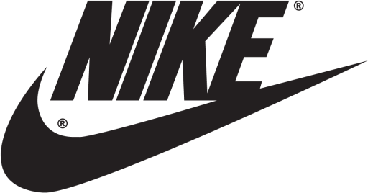
NIKE
INC.
Thank You

